Slide 1
Online BookStore
By
Abhiram Kalyan 19BCD7118
P Anushri Sowmya 19BCD7074
Alan Alexander Thomas 19BCE7588

Slide 2
What is Online BookStore?
Most of the time we can’t find our desired books of different publishers in a normal E-commerce website.
Online BookStore is a place where we can buy books from different sellers and publishers.
Through a web browser the customers can search for a book by its title or author, later can add to the shopping cart and finally purchase using credit card transaction.

Slide 3
Services used to deploy the project
We have used Amazon EC2 compute service to create a instance of microsoft windows.
Then, RDP client to access the instance created using EC2.
RDP Client:
Microsoft Remote Desktop clients let you use and control a remote PC. With a Remote Desktop client, you can do all the things with a remote PC that you can do with a physical PC

Slide 4
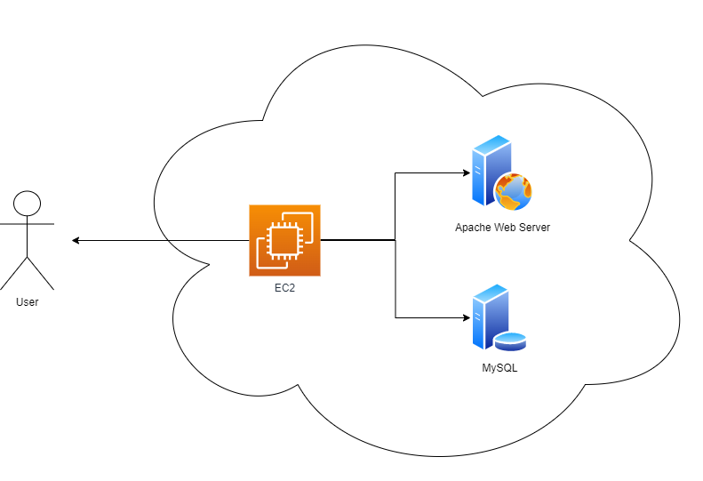
Architectural Diagram

Slide 5
AWS EC2
ELASTIC CLOUD COMPUTE
PROVIDES SCALABLE COMPUTING CAPACITY
WE CAN LAUNCH AS MANY OR AS FEW VIRTUAL SERVERS AS WE NEED
ENABLES YOU TO SCALE UP AND DOWN TO HANDLE CHANGES
DEVELOP AND DEPLOY APPLICATIONS FASTER

Slide 6
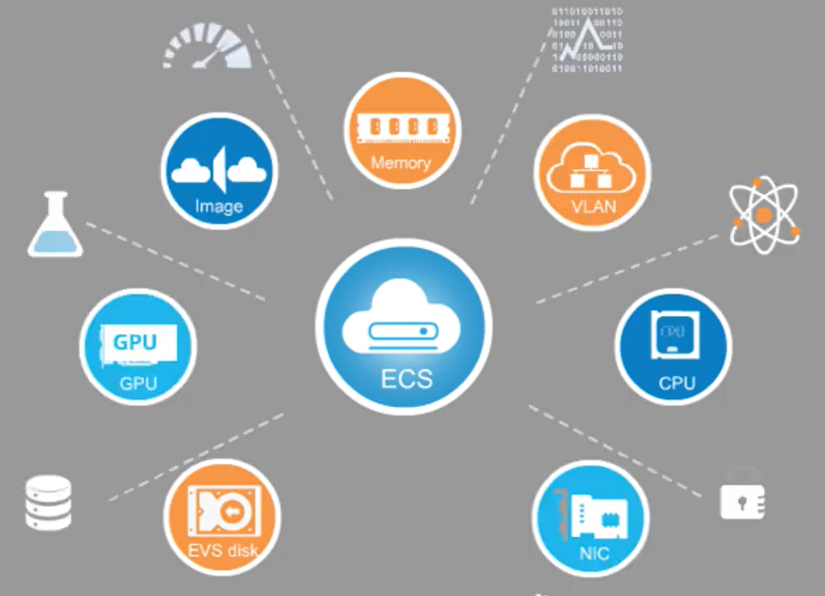
Notes:
Computing server consisting of CPUs, memory, images, and EVS Disks.

Slide 7

FEATURES OF EC2
Flexibility in configurations
Integration
Precise control
Security
Cost

Slide 8
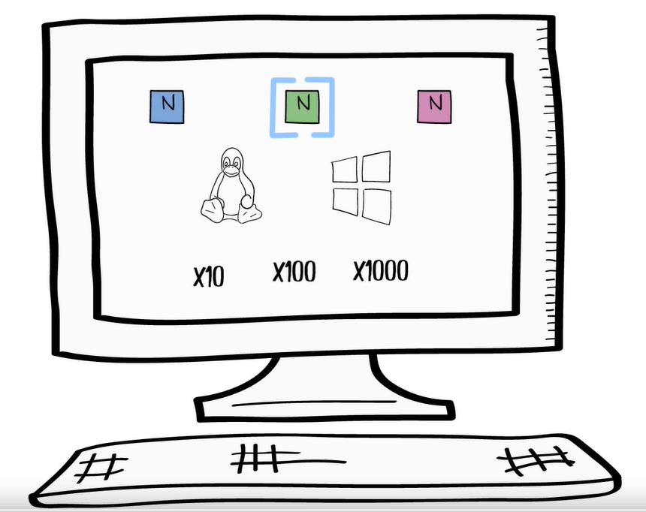

Notes:
Obtain Virtual Servers/Compute Instances in the cloud. Choose the instance type you want, the template you would like to choose, and the number of instances you wish to deploy.

Slide 9





EC2 Use Cases
Small Eco. Instance
Cluster Compute Instance
Notes:
Small instances for low volume applications. Cluster compute instances for high volume workloads.
Instances based on usage requirements.

Slide 10
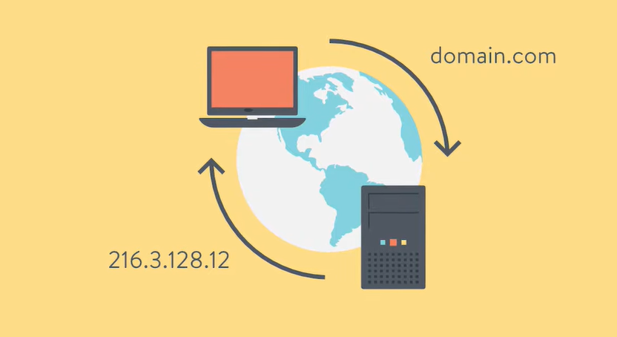
Using a Domain Name
Notes:
Domain Name’ primary purpose is to act as the website’s address. Every Computer has an IP address which is a string of numbers. Users would have to enter IP address each time the service needs to be accessed.
The EC2 server hosting our website has a designated Static IP address. Easy to recall alternative. Better than remembering and typing in the ip address every time the website needs to be accessed.

Slide 11
